Slide 1
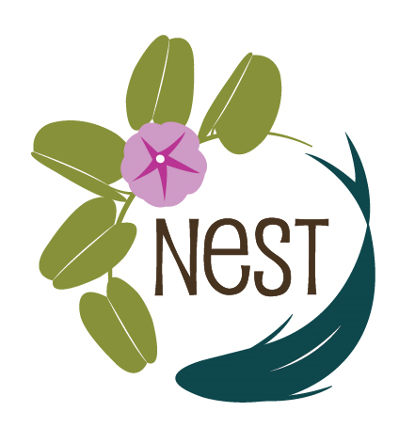
Mollie Holland
NEST
Improving water quality through native plantings

Slide 2
Basic Concepts
Why native plants?
More in tune with our local ecosystem – rainfall, temperature, soils
Requires less maintenance - trimming and fertilizing
Flowers contain pollen

Slide 3
More in tune with our local ecosystem
“More in tune with our local ecosystem – rainfall, temperature, soils”
50 % of water use in an average home goes to irrigation. Groundwater is our only safe source of drinking water.
Native plants, especially used in relation to their native ranges, can withstand heat and frost
Adapted to native soils which have little organic matter and nutrient/moisture holding potential (sometimes)

Slide 4
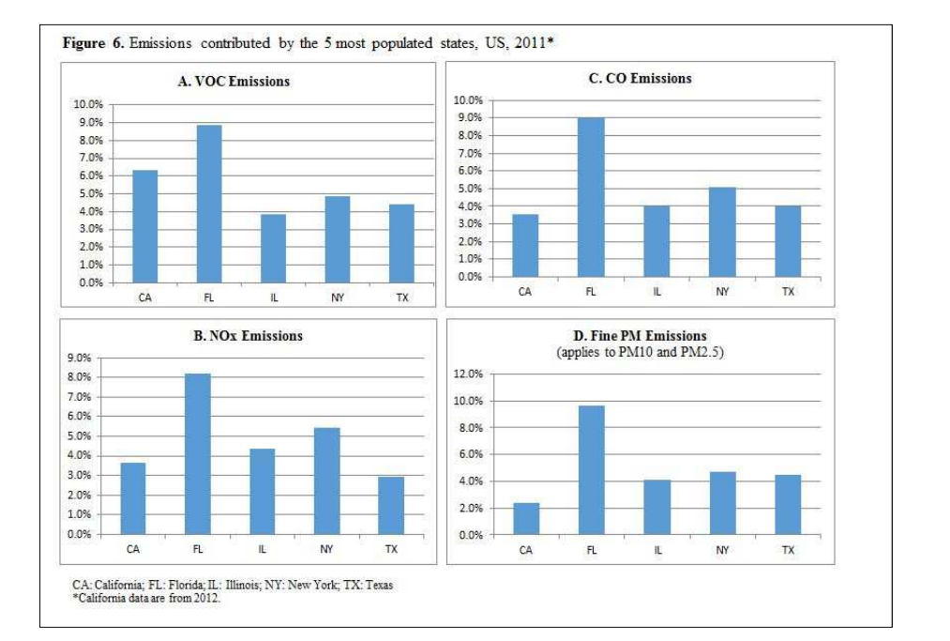
Requires less maintenance - trimming and fertilizing
National Emissions from Lawn and Garden Equipment
Jamie L Banks, PhD, MS*
Robert McConnell, Environmental Engineer
US Environmental Protection Agency, Region 1,
Notes:
2011 study

Slide 5
Requires less maintenance - trimming and fertilizing
In fiscal years 2016-2018, manufacturers distributed 7,585 tons of nitrogen-containing fertilizers to Sarasota County, with 99.8% in the form of inorganic N-P-K formulas (FDACS 2019, unpublished data). About 53% of nitrogen was distributed for use on golf courses and athletic fields, 30% for use on residential lawns, 14% on farms, and the balance for use in gardens, landscaping, nurseries, and greenhouses
Water Quality Playbook
Notes:
2,313.43 tons of inorganic fertilizer in Sarasota county. Initial studies in the IRL indicate that leaching from fertilizers has an impact on water quality.
Nitrate, nitrite, and ammonium
nitrate (NO3−) and nitrite (NO2−), the reduced ammonium ion (NH4+)

Slide 6
Flowers contain pollen
Flowers contain pollen
Unfortunately, not all cultivars and hybrids are the same.
Many of these cultivars are sterile and have no benefit to pollinators.
Others have flower structures so complex a pollinator couldn’t find its way to the center with a map, a compass, and a native guide.
More troubling, cultivars often have reduced nutritional benefits, and haven’t been well-enough studied to identify those which may be harming pollinators in that regard.
Notes:
Xerces society on hybrids
Double flowers are hard to pollinate, colors can be off putting in the UV

